Slide 1
PROJECT PRESENTATION
TOPIC : PROBABLITY
By: Habeeba A C

Slide 2
Overview
In this session we would be going through the following areas.
Probability
Trial and Event
Exhaustive Events
Mutually exclusive Event
Equally likely Events
Independent Event
Sample Space
Conditional Probability Theorem

Slide 3
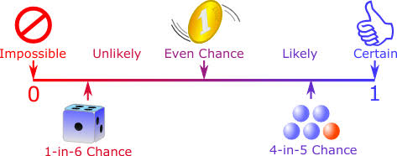
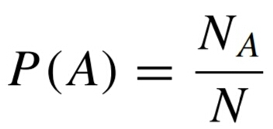
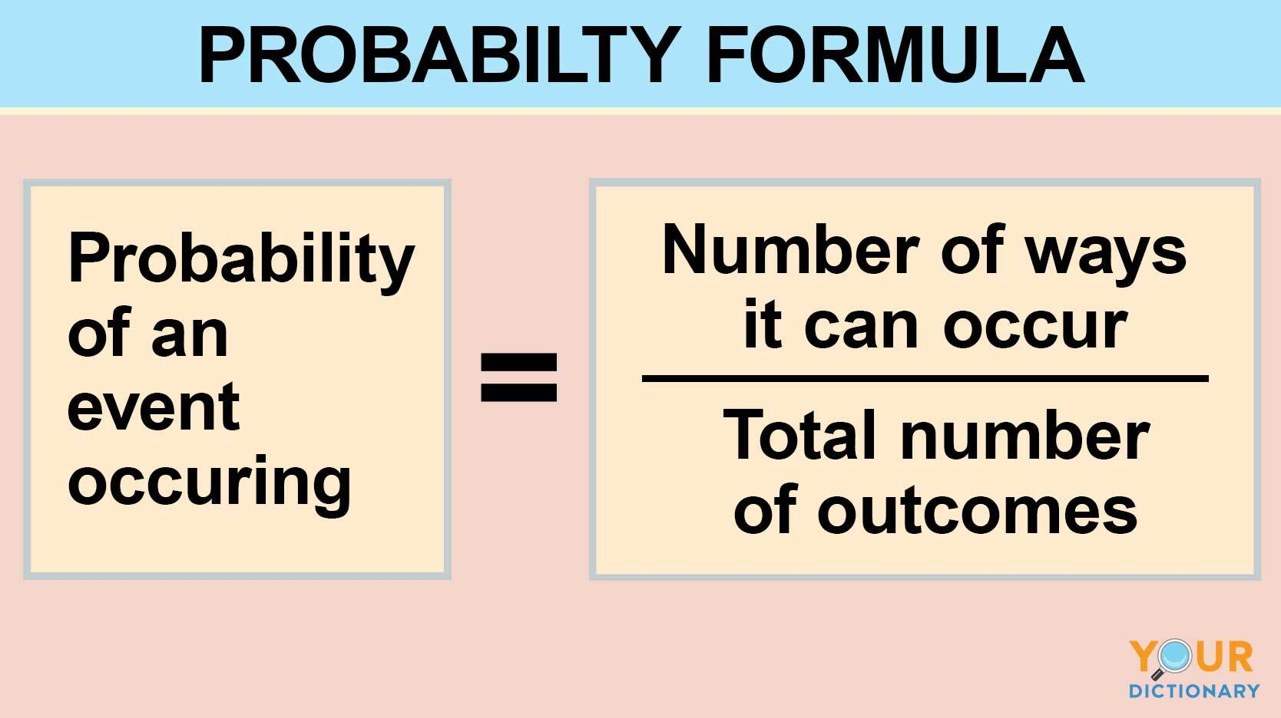
Probability

Slide 4
Trial and Event
E.g.
Throwing a dice experiment getting the numbers 1,2,3,4,5,6 (event)
Tossing a coin experiment and getting head or tail (event)
Exhaustive Events
The total no. of possible outcomes
E.g.
In tossing of a coin experiment there are two exhaustive events.
In throwing an n-dice experiment, there are n 6 exhaustive events.

Slide 5
Equally likely Events
Outcomes of events are said to be equally likely if there is no
reason for one to be preferred over other. E.g. tossing a coin.
chance of getting head & tail is equally likely.
Mutually exclusive Event
If two or more of them cannot happen simultaneously in the same
trial
E.g.
In throwing a dice experiment, the events 1,2,3,------6 are
M.E. events.

Slide 6
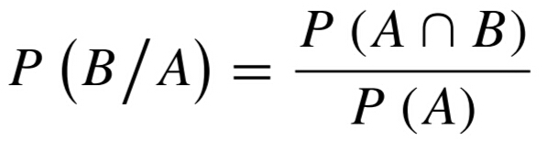
Independent Event
E.g.
In tossing a coin and throwing a die, getting head or tail is independent of
getting numbers 1 or 2 or 3 or 4 or 5 or 6.
Conditional Probability Theorem

Slide 7
Sample Space
The set of all possible outcomes.
Sample points :
The elements of this set are called.
E.g.
In throwing two dies experiment, Sample S contains 36 Sample
points. S = {(1,1) ,(1,2) ,----------(1,6), --------(6,1),(6,2),--------(6,6)}
(2) In tossing two coins experiment , S = {HH ,HT,TH,TT}
A sample space is called discrete or continuous sample space.
Discrete: Finite number of outcomes
Continuous sample space : Infinite number of outcomes

Slide 8
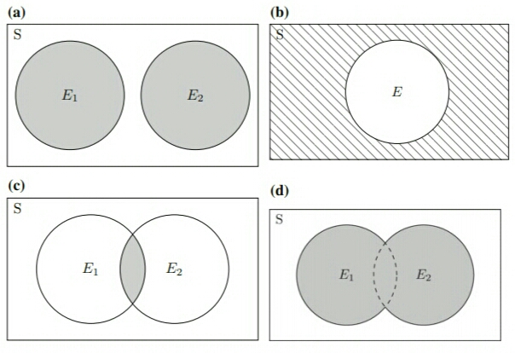
Venn diagram showing sample space, events (E,E₁, E₂) and their
inter-relationships:-
a:The Events E₁ and E₂ mutually exclusive
b:The hatched area is complement of E
c:The shaded area is intersection of E₁ and E₂
d:The shaded area is union of events of E₁ and E₂

Slide 9
THANKS

